Slide 1
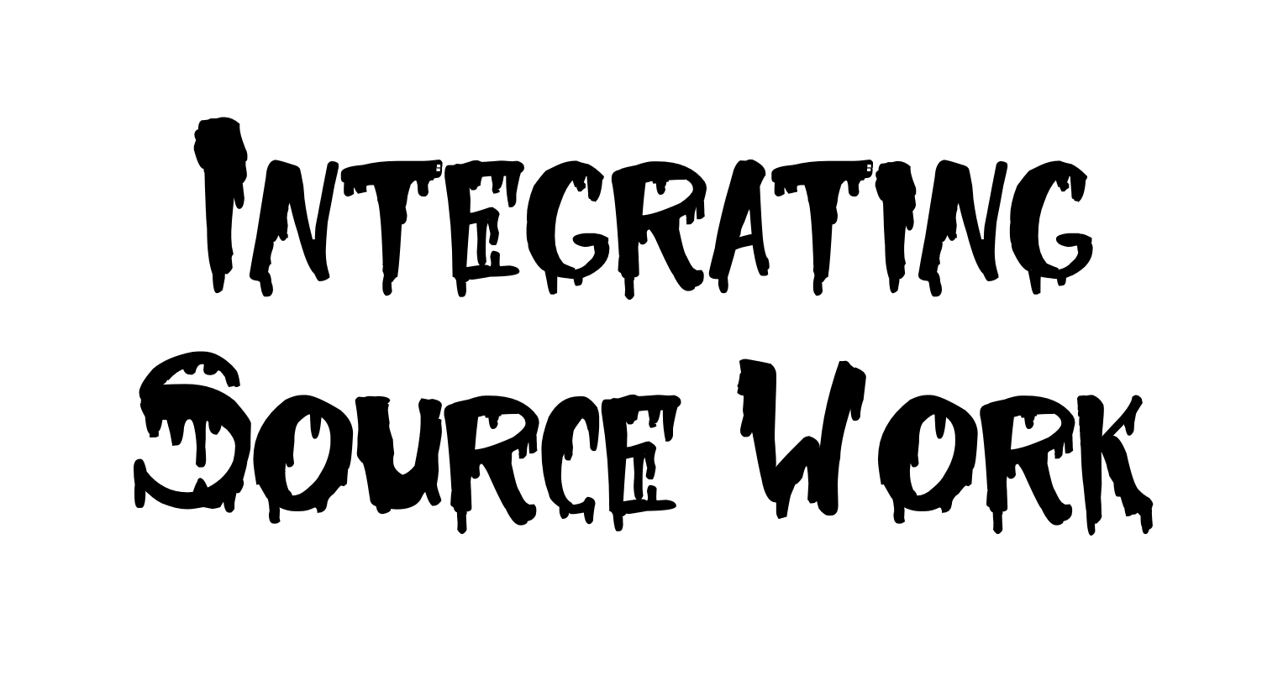
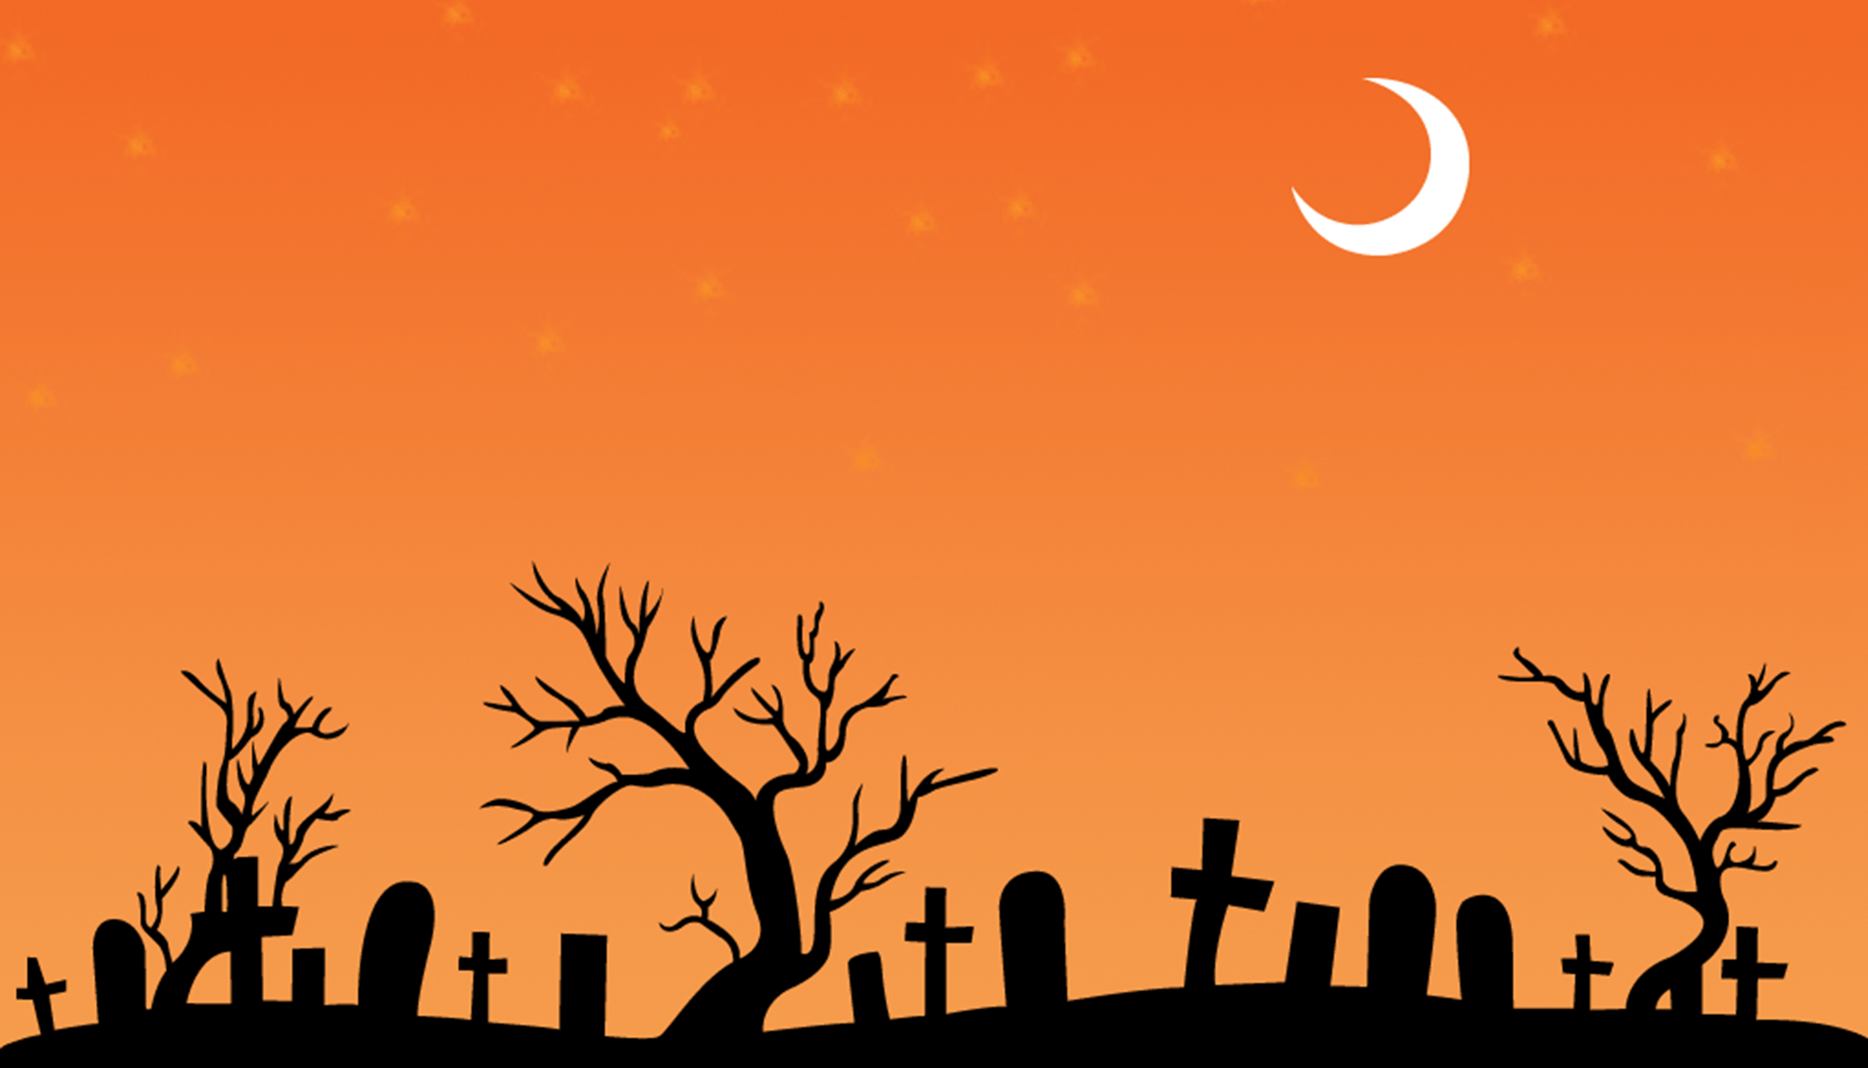

Slide 2
From the Merriam –Webster webpage:
to steal and pass off (the ideas or words of another) as one's own
to use (another's production) without crediting the source
to commit literary theft
to present as new and original an idea or product derived from an existing source
Considered a violation of the ethics of academic writing
At UMD, includes using previous work from past semesters without citation

Slide 4
