Slide 1
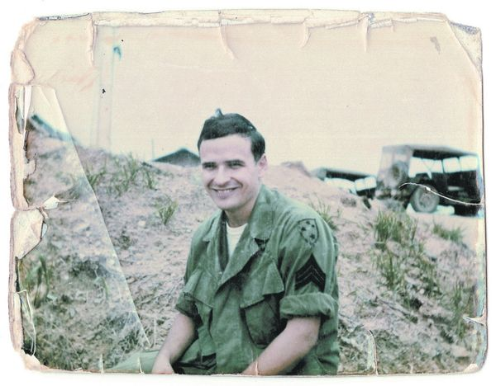
The Things They Carried: Considering Inquiry in Creative Writing

Slide 2
Some Warm up Questions
What are some of the things they carry? What are some similarities with these things? What are some differences?
Do you get a sense for the way the platoon feels about the war? What are those feelings? How do they feel about death?
What is the significance of the repetition of the phrase “the things they carry?”

Slide 3
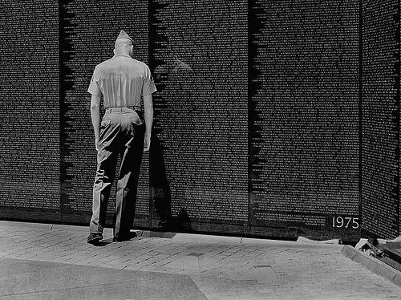
Even More Warm up Questions
What kind of rhetorical appeals is O’Brien using? What is his ethos? Pathos? Logos? Is his Kairos still relevant?

Slide 4
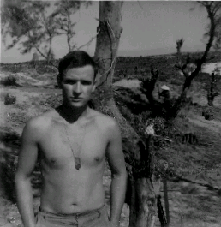
TTTC and the Inquiry Paper
Imagine that Tim O’Brien is here and writing an introduction to an inquiry. What questions is he asking implicitly or explicitly?
How can these rhetorical devices (imagery, diction, tone, figurative language) lead us to ask questions about the world around us in a new way?

Slide 5
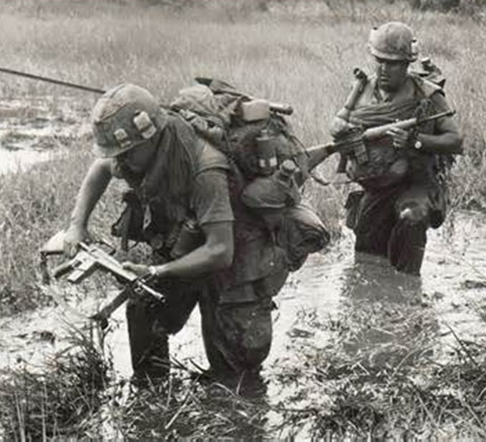
Inquiry in Our Own Lives
If we consider this story as an inquiry, we start to see how we can use experiences from our own lives to form our own questions about the world that we feel need answering.
How can we interpret the techniques and devices seen here to make our own inquiry?

